Slide 1
Venue building
The conference will be hold on the Building “Maison des Sciences de l’Environnement" of the OSU-EFLUVE (Observatory of Earth and Space Sciences: Fluid Envelopes from the Urban Scale to Astrobiology) of University of Paris-Est Creteil, at Creteil (France).
Venue Adress : 5 Rue Pasteur Vallery Radot, 94000 Creteil
Venue mappy link : https://goo.gl/maps/XU1HaCEyWZpwzPBQ8

Slide 2
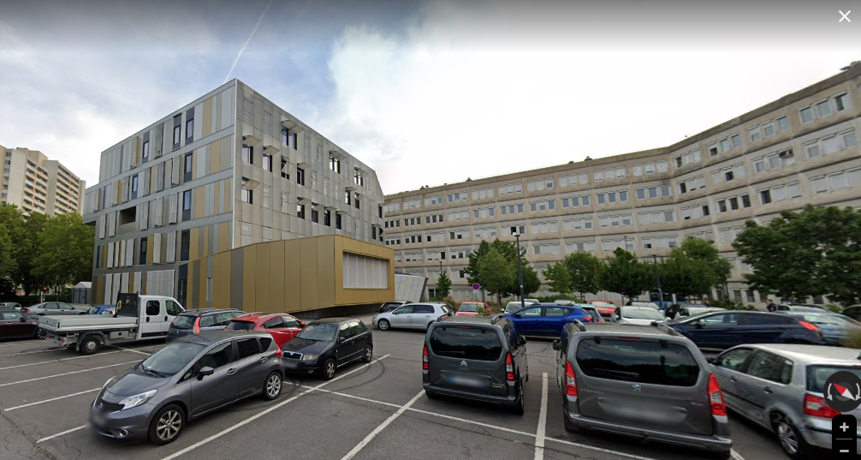
Venue building

Slide 3
Hotels
1. Novotel Paris Créteil Le Lac **** (https://goo.gl/maps/sRUr3mZRr6yvUQ1w8)
Novotel is the nearest to the university.
It is in front of the Big Mosque of Creteil and at 5 minutes of walking, on Rue Pasteur Vallery Radot, to the university's campus.
From Paris to the conference venue, there is metro line 8 (stop : Creteil Universite), for someone reserving hotel in Paris
2. Hotel ibis Creteil
Adresse : 14, Rue Basse Quinte Carrefour Pompadour, Z.A. Grands, Imp. des Marais, 94000 Créteil
https://goo.gl/maps/w3omCjD2ZooXDxCw5
Bus TVM : Direction (Saint Maur Creteil), Stop at the first station « Base de Loisirs de Creteil » and walking on Rue Pasteur Vallery Radot, to the Unversity campus (look for the below map)
3. Hôtel Campanile Créteil Centre
Adresse : 52 Av. du Chemin de Mesly, 94000 Créteil
https://www.hotel-campanile-creteil.fr/
https://goo.gl/maps/iqmkjKDv49VKtgjV8
Metro 8 station Prefecture, direction Balard, stop Creteil Universite (first station from Centre commercial Creteil Soleil : Mall in front of the hotel Campanile)

Slide 4
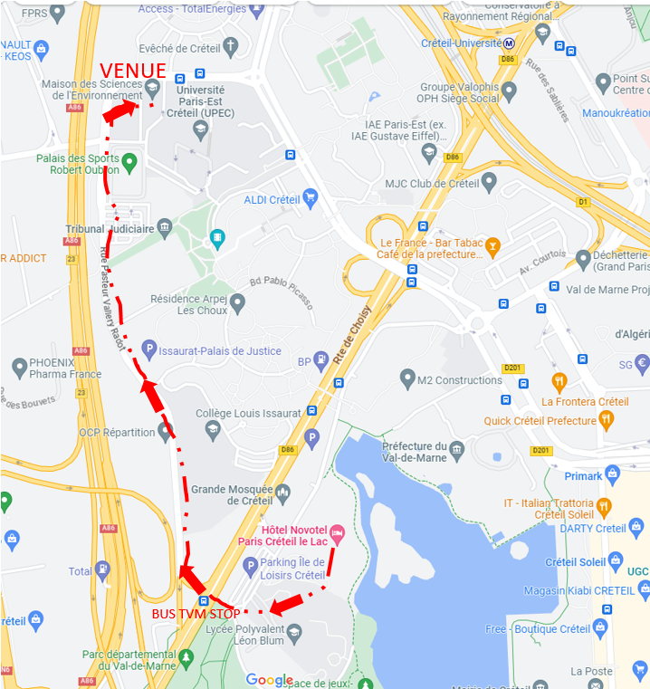
Walking direction from hotels

